Slide 1
Chapter Four
The OSI and TCP/IP Models

Slide 2
Communication and Layer Architecture
A network is a combination of hardware and software that sends data from one location to another.
The hardware consists of the physical equipment that carries signals from one point of the network to another.
The software consists of instruction sets that make possible the services that we expect from a network
For example, the task of sending an e-mail from one point in the world to another can be broken into several tasks, each performed by a separate software package.

Slide 3
Communication and Layer Architecture----
Each software package uses the services of another software package.
At the lowest layer, a signal, or a set of signals, is sent from the source computer to the destination computer.

Slide 4
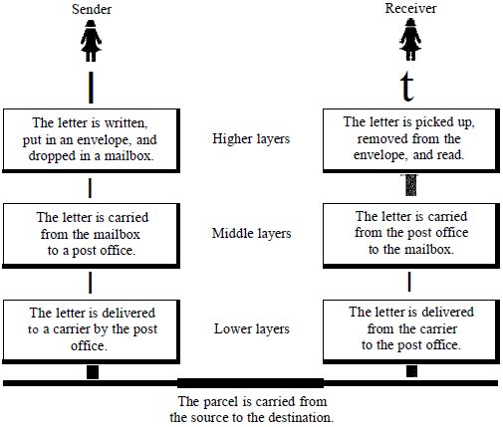
Layered Tasks
We use the concept of layers in our daily life.
As an example, let us consider two friends who communicate through postal mail.
The process of sending a letter to a friend would be complex if there were no services available from the post office.

Slide 5
The need for Standards
Without agreed on common standards,
devices made by different manufacturers or vendors would not be able to communicate.
A protocol is a set of rules that determines how two devices will communicate.
Networking standards define the rules for data communications that are needed for interoperability of networking technologies and processes.
Notes:
Interoperability-The capability of a product or system to interact and function with other reiprocically

Slide 6
The need for Standards-----
Standards help in
creating and maintaining open markets and
allow different vendors to compete on the basis of the quality of their products while being compatible with existing market products.
Over the past years many of the networks that were built used different hardware and software implementations,
as a result they were incompatible and it became difficult for networks using different specifications to communicate with each other.

Slide 7
The need for Standards-----
To address the problem of networks being incompatible and unable to communicate with each other,
the International Standardisation for Organisation (ISO) researched various network schemes.
The ISO recognised there was a need to create a NETWORK MODEL that would help vendors create interoperable network implementations.

Slide 8
Contd.
A communication architecture is a strategy for connecting host computers and other communicating equipment.
It defines necessary elements for data communication between devices.
A communication architecture, therefore, defines a standard for the communicating hosts.
A programmer formats data in a manner defined by the communication architecture and passes it on to the communication software.

Slide 9
Contd.
Separating communication functions adds flexibility, for example, we do not need to modify the entire host software to include more communication devices.
Layer architecture simplifies the network design.
It is easy to debug network applications in a layered architecture network.
The network management is easier due to the layered architecture.
Network layers follow a set of rules, called protocol.
The protocol defines the format of the data being exchanged, and the control and timing for the handshake between layers.

Slide 10
Open Systems Interconnection (OSI)
International standard organization (ISO) established a committee in 1977 to develop an architecture for computer communication.
Open Systems Interconnection (OSI) reference model is the result of this effort.
In 1984, the Open Systems Interconnection (OSI) reference model was approved as an international standard for communications architecture.
The term “open” denotes the ability to connect any two systems which conform to the reference model and associated standards.

Slide 11
Open Systems Interconnection (OSI)-----
The OSI model is now considered the primary Architectural model for inter-computer communications.
The OSI model describes how information or data makes its way from application programmes(such as spreadsheets) through a network medium (such as wire) to another application programme located on another network.
The OSI reference model divides the problem of moving information between computers over a network medium into SEVEN smaller and more manageable problems.
This separation into smaller more manageable functions is known as layering.

Slide 12
The Seven Layers
Layer 7
Layer 6
Layer 5
Layer 4
Layer 3
Layer 2
Layer 1

Slide 13
Contd.
The figure in the next slide shows the layers involved when a message is sent from device A to device B.
As the message travels from A to B, it may pass through many intermediate nodes.
These intermediate nodes usually involve only the first three bottom layers of the OSI model.

Slide 14
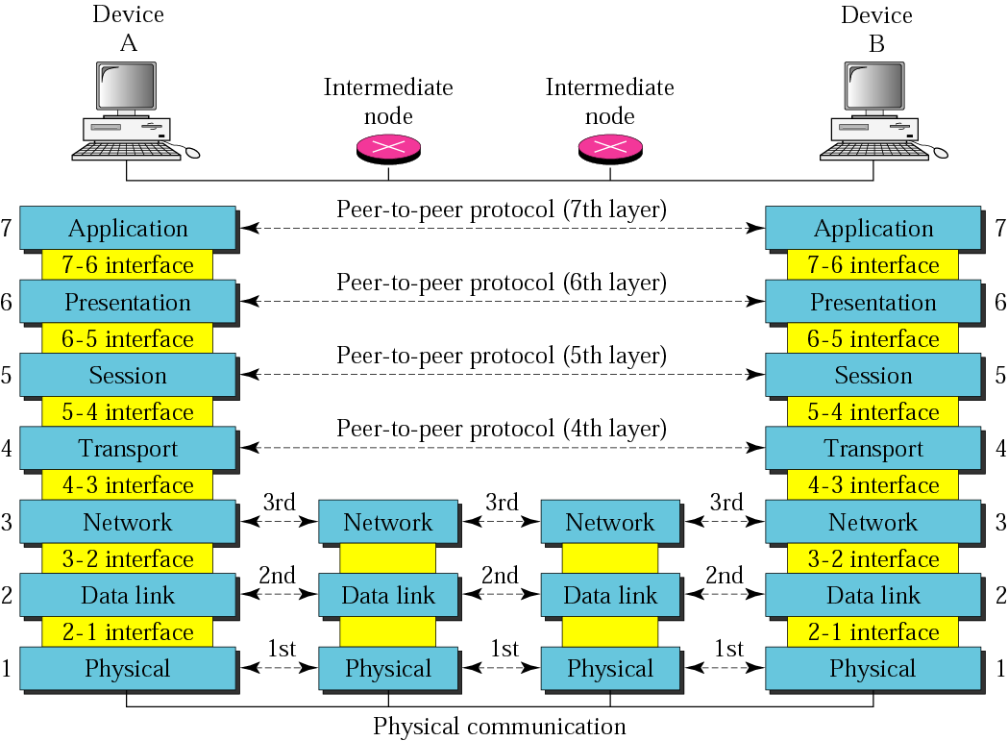
Contd.

Slide 15
Contd.
In developing the model, the designers distilled the process of transmitting data to its most fundamental elements.
They identified which networking functions had related uses and collected those functions into discrete groups that became the layers.
Each layer defines a family of functions distinct from those of the other layers.
By defining and localizing functionality in this fashion, the designers created an architecture that is both comprehensive and flexible.

Slide 16
Contd.
Most importantly, the OSI model allows complete interoperability between otherwise incompatible systems.
Within a single machine, each layer calls upon the services of the layer just below it.
Layer 3, for example, uses the services provided by layer 2 and provides services for layer 4.
Between machines, layer x on one machine communicates with layer x on another machine.
This communication is governed by an agreed-upon series of rules and conventions called protocols.

Slide 17
Cont----
The processes on each machine that communicate at a given layer are called peer-to-peer processes.
Communication between machines is therefore a peer-to-peer process using the protocols appropriate to a given layer.

Slide 18
Peer-to-Peer Processes
At the physical layer, communication is direct:
At the higher layers, however, communication must move down through the layers on device A, over to device B, and then back up through the layers.
Each layer in the sending device adds its own information to the message it receives from the layer just above it and passes the whole package to the layer just below it.
At layer 1 the entire package is converted to a form that can be transmitted to the receiving device.

Slide 19
Peer-to-Peer Processes------
At the receiving machine, the message is unwrapped layer by layer, with each process receiving and removing the data meant for it.
For example, layer 2 removes the data meant for it, then passes the rest to layer 3.
Layer 3 then removes the data meant for it and passes the rest to layer 4, and so on.

Slide 20
Interfaces Between Layers
The passing of the data and network information down through the layers of the
sending device and back up through the layers of the receiving device is made possible by an
interface between each pair of adjacent layers.
Each interface defines the information and services a layer must provide for the layer above it.
Well-defined interfaces and layer functions provide modularity to a network.

Slide 21
Interfaces Between Layers---
As long as a layer provides the expected services to the layer above it,
the specific implementation of its functions can be modified or replaced without requiring
changes to the surrounding layers.

Slide 22
Organization of the Layers
The seven layers can be thought of as belonging to three subgroups.
Layers 1, 2, and 3 - physical, data link, and network - are the network support layers;
they deal with the physical aspects of moving data from one device to another (such as
electrical specifications, physical connections, physical addressing, and transport timing and reliability).

Slide 23
Cont----
Layers 5, 6, and 7- session, presentation, and application-can be thought of as
the user support layers; they allow interoperability among unrelated software systems.
Layer 4, the transport layer,
links the two subgroups and ensures that what the lower layers have transmitted is in a form that the upper layers can use.

Slide 24
Contd.
The upper OSI layers are almost always implemented in software;
lower layers are a combination of hardware and software, except for the physical layer, which is mostly hardware
The figure shown in the next slide, gives an overall view of the OSI layers,
D7 means the data unit at layer 7, D6 means the data unit at layer 6, and so on.
The process starts at layer 7 (the application layer), then moves from layer to layer in descending, sequential order.

Slide 25
Contd.
At each layer, a header, or possibly a trailer, can be added to the data unit.
Commonly, the trailer is added only at layer 2.
When the formatted data unit passes through the physical layer (layer 1),
it is changed into an electromagnetic signal and transported along a physical link.

Slide 26
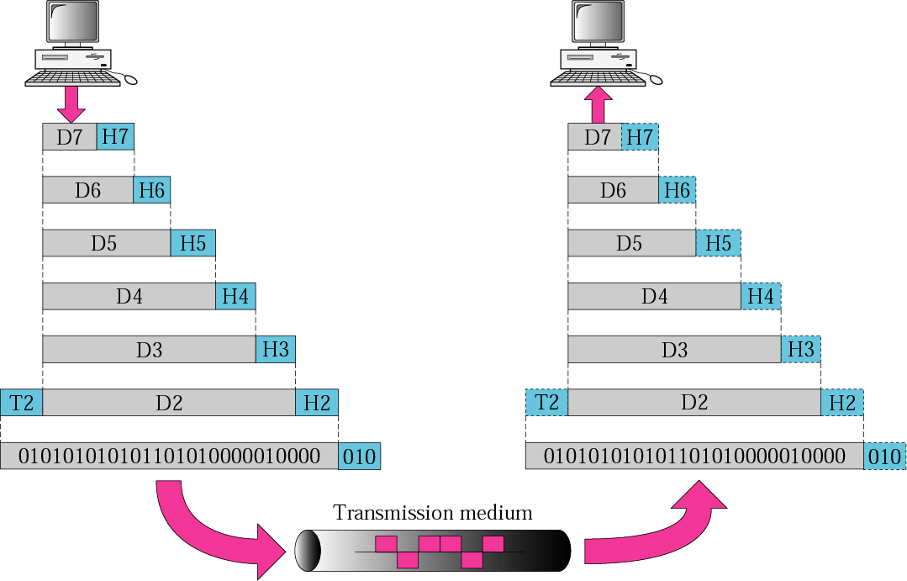
An exchange using the OSI model

Slide 27
Contd.
Upon reaching its destination, the signal passes into layer 1 and is transformed back into digital form.
The data units then move back up through the OSI layers.
As each block of data reaches the next higher layer,
the headers and trailers attached to it at the corresponding sending layer are removed, and actions appropriate to that layer are taken.
By the time it reaches layer 7,
the message is again in a form appropriate to the application and is made available to the recipient.

Slide 28
Encapsulation
A packet (header and data) at level 7 is encapsulated in a packet at level 6.
The whole packet at level 6 is encapsulated in a packet at level 5, and so on.
In other words, data portion of a packet at level N-1 carries the whole packet (data and header and may be trailer) from level N.
The concept is called encapsulation; level N - 1 is not aware of which part of the encapsulated packet is data and which part is the header or trailer.
For level N - 1, the whole packet coming from level N is treated as one integral unit.

Slide 29
Benefits of OSI Model
Provide a wide variety of choice
Customers have a wide variety of choice since software/ hardware from different manufactures work together in harmony.
OSI model can fit to any compatible software/hardware from different users in other parts of the world.
2. It does not rely on a specific operating system
OSI is convenient since errors are dealt with at each level, as different levels operate automatically independent of each other.

Slide 30
Benefits of OSI Model -----
This makes it easier to troubleshoot problems that may arise at each stage, by separating the networks into small manageable pieces.
3. To understand the common terms used in networking
OSI model also help the user to understand different networking terms and functional relationship applied on multiple networks.
In addition, the user also understand how new technologies are developed in the existing networks.

Slide 31
Benefits of OSI Model-----
4. Interprets product functionality at each stage
The OSI model simply uses different stages of functionality.
For instance, each stage has specific functions to ensure all networks operate without technical hitches.
Also, each layer has it own interface specifications and a well-defined connector.
5. Encrypt data for security purposes
Decryption and encryption services are also available for security purposes.
Expansion and compression of messages is simplified to ensure it travels from one system to another efficiently.
.

Slide 32
Benefits of OSI Model------
6. It is easier to add multiple network models
The OSI model is designed in such a way that user further extend new protocols within the process.
This means you can use additional layered architecture other than the existing one.
Due to its complexity, poor performance can be obtained in day to day applications, thereby it requires great technical know-how

Slide 33
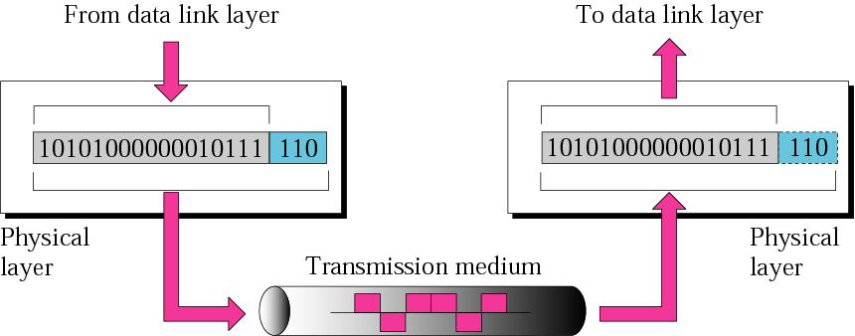
1. Physical Layer
The physical layer coordinates the functions required to carry a bit stream over a physical medium.
It deals with the mechanical and electrical specifications of the interface and transmission medium.
It also defines the procedures and functions that physical devices and interfaces have to perform for transmission to occur.
The physical layer is responsible for movements of individual bits from one hop (node) to the next.

Slide 34
1. Physical Layer
The physical layer is also concerned with the following:
Physical characteristics of interfaces and medium
The physical layer defines the characteristics of the interface between the devices and the transmission medium.
It also defines the type of transmission medium.
2. Representation of bits.
The physical layer data consists of a stream of bits (sequence of 0s or 1s) with no interpretation.

Slide 35
Contd.
To be transmitted, bits must be encoded into signals - electrical or optical.
The physical layer defines the type of encoding (how 0s and 1s are changed to signals).
3. Data rate.
The transmission rate - the number of bits sent each second - is also defined by the physical layer.
In other words, the physical layer defines the duration of a bit, which is how long it lasts.

Slide 36
Contd.
4. Synchronization of bits.
The sender and receiver not only must use the same bit rate but also must be synchronized at the bit level.
In other words, the sender and the receiver clocks must be synchronized.
5. Line configuration.
The physical layer is concerned with the connection of devices to the media (point – to – point or multipoint).

Slide 37
Contd.
6. Physical topology.
The physical topology defines how devices are connected to make a network.
7. Transmission mode.
The physical layer also defines the direction of transmission between two devices: simplex, half-duplex, or full-duplex.

Slide 38
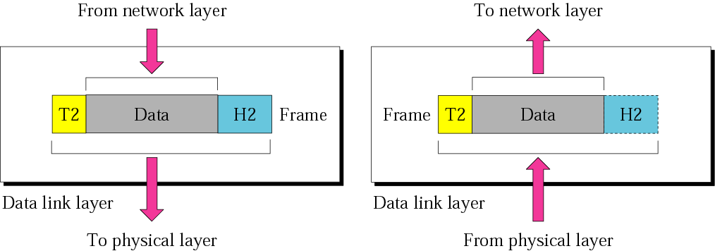
2. Data Link Layer
The data link layer transforms the physical layer, a raw transmission facility, to a reliable link.
It makes the physical layer appear error-free to the upper layer (network layer).
The following figure shows the relationship of the data link layer to the network and physical layers.
The data link layer is responsible for moving frames from one hop (node) to the next.

Slide 39
Layer 2 frame structure
Start Frame (Flag) | Header |  | Data | Trailer | Stop Frame (Flag)
 | Address | Type/Length |  | FCS
Data Link Layer Responsibilities
Framing
The data link layer divides the packets received from the network layer into manageable data units called frames.
2. Physical addressing
If frames are to be distributed to different systems on the network, the data link layer adds a header to the frame to define the sender and/or receiver of the frame.

Slide 40
Contd.
If the frame is intended for a system outside the sender‘s network, the receiver address is the address of the device that connects the network to the next one.
Flow control
If the rate at which the data are absorbed by the receiver is less than
the rate at which data are produced in the sender,
the data link layer imposes a flow control mechanism to avoid overwhelming the receiver.

Slide 41
Contd.
4. Error control
The data link layer adds reliability to the physical layer by adding mechanisms to detect and retransmit damaged or lost frames.
It also uses a mechanism to recognize duplicate frames.
Error control is normally achieved through a trailer added to the end of the frame.
5. Access control
When two or more devices are connected to the same link, data link layer protocols are necessary to determine which device has control over the link at any given time.

Slide 42
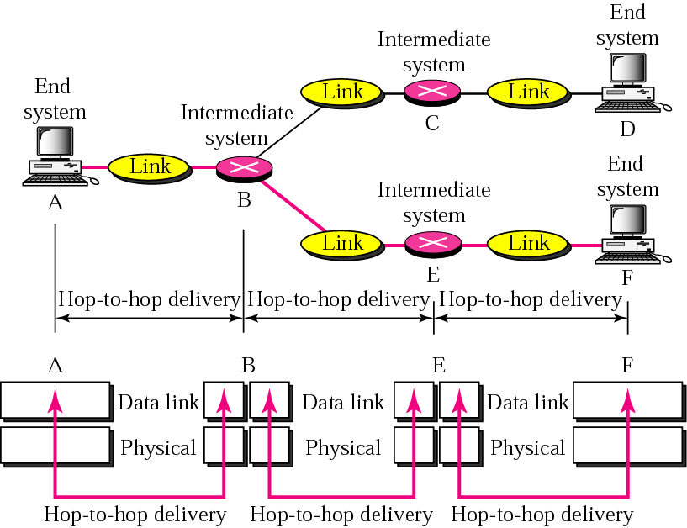
Hop-to-hop (node-to-node) delivery by data link layer

Slide 43
Contd.
As the figure above shows, communication at the data link layer occurs between two adjacent nodes.
To send data from A to F, three partial deliveries are made.
First, the data link layer at A sends a frame to the data link layer at B (a router).
Second, the data link layer at B sends a new frame to the data link layer at E.
Finally, the data link layer at E sends a new frame to the data link layer at F.

Slide 44
Contd.
Note that the frames that are exchanged between the three nodes have different values in the headers.
The frame from A to B has B as the destination address and A as the source address.
The frame from B to E has E as the destination address and B as the source address.
The frame from E to F has F as the destination address and E as the source address.
The values of the trailers can also be different if error checking includes the header of the frame.

Slide 45
Framing
The data link layer, needs to pack bits into frames,
so that each frame is distinguishable from another.
Our postal system practices a type of framing.
The simple act of inserting a letter into an envelope separates one piece of information from another; the envelope serves as the delimiter.
In addition, each envelope defines the
sender and receiver addresses since the postal system is a many-to-many carrier facility.

Slide 46
Cont----
Framing in the data link layer separates a message from
one source to a destination, or from other messages to other destinations, by adding
a sender address and a destination address.
The destination address defines where the packet is to go; the sender address helps the recipient acknowledge the receipt.
NB: Addressing here is about the next node in the LAN
Although the whole message could be packed in one frame, that is not normally done.

Slide 47
Contd.
One reason is that a frame can be very large, making flow and error control very inefficient.
When a message is carried in one very large frame,
even a single-bit error would require the retransmission of the whole message.
When a message is divided into smaller frames, a single-bit error affects only that small frame.
Frames can be of:
Fixed size Framing
Variable size Framing

Slide 48
Fixed-Size Framing
In fixed-size framing, there is no need for defining the boundaries of the frames; the size itself can be used as a delimiter.
An example of this type of framing is the ATM wide-area network, which uses frames of fixed size called cells.
2. Variable-Size Framing
Variable-size framing is prevalent in local area networks.
In variable-size framing, we need a way to define the end of the frame and the beginning of the next.
Historically, two approaches were used for this purpose: a character-oriented approach and a bit-oriented approach.
Notes:
delimiter- a unique or series of characters that indicates the beginning or
end of a specific statements, string or function body test

Slide 49
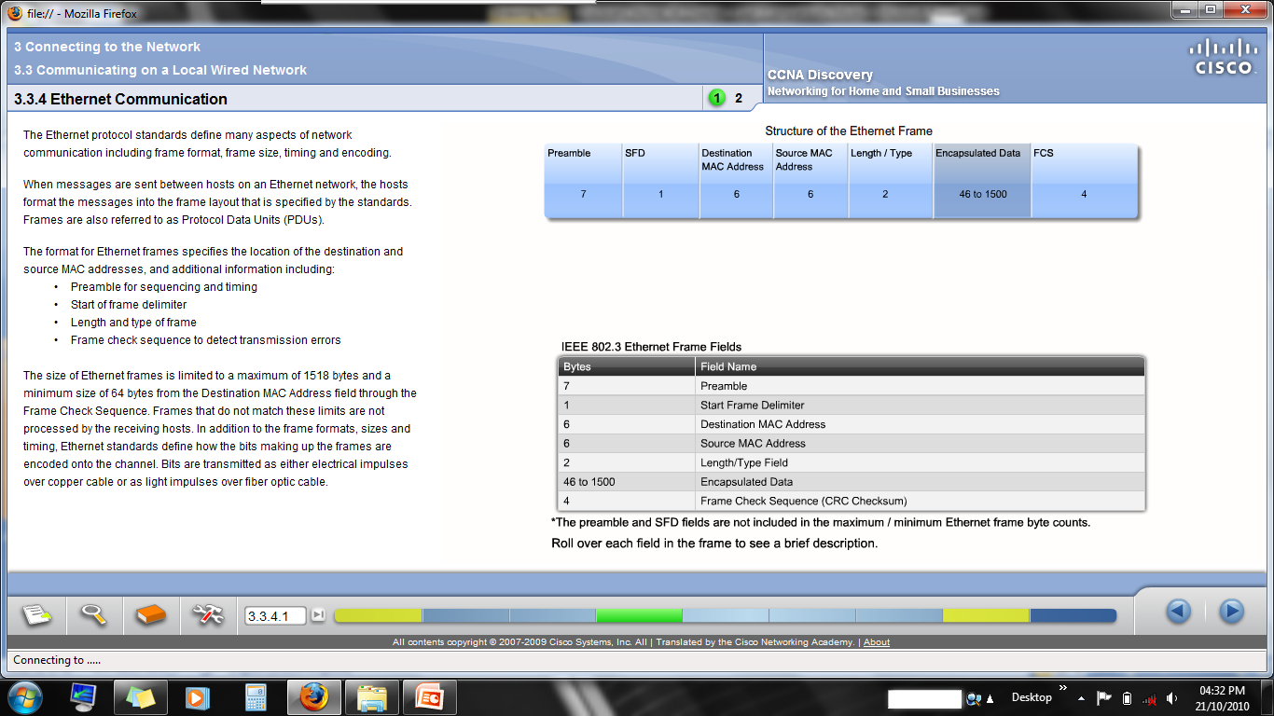
Character-Oriented Protocols
In a character-oriented protocol, data to be carried are 8-bit characters from a coding system such as ASCII.
The header, which normally carries the source and destination addresses and other control information, and
the trailer, which carries error detection or
error correction redundant bits,
are also multiples of 8 bits.
Notes:
Trailer-is the last part of the frame, often containing a check sequence

Slide 50
Character-Oriented Protocols-----
To separate one frame from the next, an 8-bit (1-byte) flag is added at the beginning and the end of a frame.
The flag, composed of protocol-dependent special characters, signals the start or end of a frame.
Character-oriented framing was popular when only text was exchanged by the data link layers.
The flag could be selected to be any character not used for text communication.
Now, however, we send other types of information such as graphs, audio, and video.

Slide 51
Character-Oriented Protocols-----
Any pattern used for the flag could also be part of the information.
If this happens, the receiver, when it encounters this pattern in the middle of the data, thinks it has reached the end of the frame.
To fix this problem, a byte-stuffing strategy was added to character-oriented framing.
In byte stuffing (or character stuffing),
a special byte is added to the data section of the frame when there is a character with the same pattern as the flag.
The data section is stuffed with an extra byte.

Slide 52
Character-Oriented Protocols-----
This byte is usually called the escape character (ESC), which has a predefined bit pattern.
Whenever the receiver encounters the ESC character,
it removes it from the data section and
treats the next character as data, not a delimiting flag.
Byte stuffing by the escape character allows the presence of the flag in the data section of the frame, but it creates another problem.
What happens if the text contains one or more normal escape characters followed by a flag?

Slide 53
Character-Oriented Protocols-----
The receiver removes the escape character, but keeps the flag, which is incorrectly interpreted as the end of the frame.
To solve this problem, the escape characters that are part of the text must also be marked by another escape character.
In other words, if the escape character is part of the text, an extra one is added to show that the second one is part of the text.

Slide 54
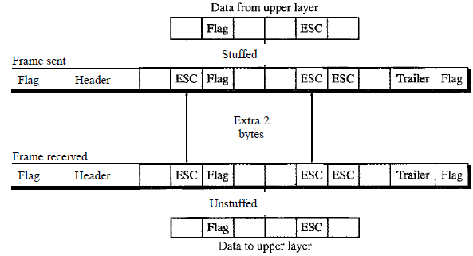
Contd.
Byte stuffing is the process of adding 1 extra byte whenever there is a flag or escape character in the text.

Slide 55
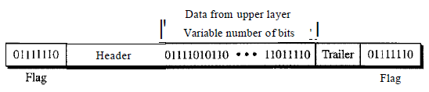
2. Bit-Oriented Protocols
In a bit-oriented protocol, the data section of a frame is a sequence of bits to be interpreted by the upper layer as text, graphic, audio, video, and so on.
However, in addition to headers (and possible trailers), we still need a delimiter to separate one frame from the other.
Most protocols use a special 8-bit pattern flag 01111110 as the delimiter to define the beginning and the end of the frame, as shown in the figure.

Slide 56
Contd.
This flag can create the same type of problem we saw in the byte-oriented protocols.
That is, if the flag pattern appears in the data, we need to somehow inform the receiver that this is not the end of the frame.
We do this by stuffing 1 single bit (instead of 1 byte) to prevent the pattern from looking like a flag.
The strategy is called bit stuffing.
In bit stuffing, if a 0 and five consecutive 1 bits are encountered, an extra 0 is added.

Slide 57
Contd.
This extra stuffed bit is eventually removed from the data by the receiver.
Note that the extra bit is added after one 0 followed by five 1s regardless of the value of the next bit.
This guarantees that the flag field sequence does not inadvertently appear in the frame.

Slide 58
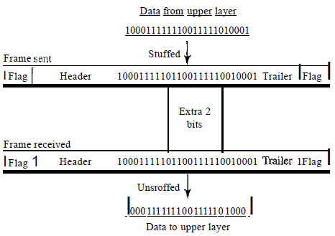
Contd.
Bit stuffing is the process of adding one extra 0 whenever five consecutive 1s follow a 0 in the data, so that the receiver does not mistaken the pattern 0111110 for a flag.

Slide 59
Contd.
The above figure shows bit stuffing at the sender and bit removal at the receiver.
Note that even if we have a 0 after five 1s, we still stuff a 0.
The 0 will be removed by the receiver.
This means that if the flag like pattern 01111110 appears in the data, it will change to 011111010 (stuffed) and is not mistaken as a flag by the receiver.
The real flag 01111110 is not stuffed by the sender and is recognized by the receiver as a flag.

Slide 60
2. Flow Control
Flow control coordinates the amount of data that can be sent before receiving an acknowledgment and is one of the most important duties of the data link layer.
In most protocols, flow control is a set of procedures that tells the sender how much data it can transmit before it must wait for an acknowledgment from the receiver.
The flow of data must not be allowed to overwhelm the receiver.
Any receiving device has a limited speed at which it can process incoming data and a limited amount of memory in which to store incoming data.

Slide 61
Contd.
The receiving device must be able to inform the sending device before those limits are reached and to request that the transmitting device send fewer frames or stop temporarily.
Incoming data must be checked and processed before they can be used.
The rate of such processing is often slower than the rate of transmission.

Slide 62
Contd.
For this reason, each receiving device has a block of memory, called a buffer, reserved for storing incoming data until they are processed.
If the buffer begins to fill up, the receiver must be able to tell the sender to halt transmission until it is once again able to receive.

Slide 63
3. Media Access control
The data link layer can further be divided in to two layers:
The upper sub-layer that is responsible for flow and error control is called the logical link control (LLC) layer;
The lower sub-layer that is mostly responsible for multiple access resolution is called the media access control (MAC) layer
When nodes or stations are connected and use a common link, called a multipoint or broadcast link,
we need a multiple-access protocol to coordinate access to the link.

Slide 64
3. Media Access control-----
The problem of controlling the access to the medium is similar to the rules of speaking in an assembly.
The procedures guarantee that the right to speak is upheld and ensure that two people do not speak at the same time,
do not interrupt each other, do not monopolize the discussion, and so on.

Slide 65
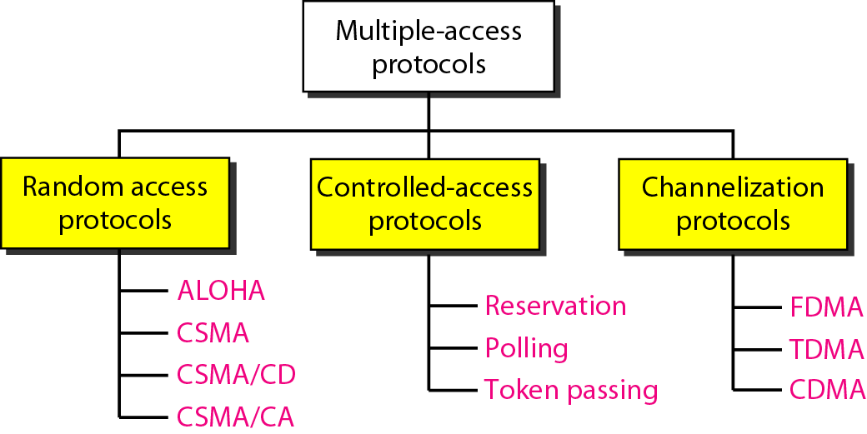
Contd.
Read about channelization protocols:
Frequency Division Multiple Access (FDMA), Time Division Multiple Access (TDMA), and Code Division Multiple Access (CDMA)

Slide 66
3.1 Random Access
In random access or contention methods, no station is superior to another station and none is assigned the control over another.
No station permits, or does not permit, another station to send.
At each instance, a station that has data to send uses a procedure defined by the protocol to make a decision on whether or not to send.
This decision depends on the state of the medium (idle or busy).

Slide 67
Contd.
In other words, each station can transmit when it desires on the condition that it follows the predefined procedure, including the testing of the state of the medium.
In a random access method, each station has the right to the medium without being controlled by any other station.
However, if more than one station tries to send, there is an access conflict-collision-and the frames will be either destroyed or modified.
To avoid access conflict or to resolve it when it happens, each station follows a procedure that answers the following questions:

Slide 68
Contd.
When can the station access the medium?
What can the station do if the medium is busy?
How can the station determine the success or failure of the transmission?
What can the station do if there is an access conflict?
The random access methods have evolved from a very interesting protocol known as ALOHA, which used a very simple procedure called multiple access (MA).
The method was improved with the addition of a procedure that forces the station to sense the medium before transmitting.

Slide 69
Contd.
This was called carrier sense multiple access.
This method later evolved into two parallel methods:
Carrier Sense Multiple Access with Collision Detection (CSMA/CD) and
Carrier Sense Multiple Access with Collision Avoidance (CSMA/CA).
CSMA/CD tells the station what to do when a collision is detected.
CSMA/CA tries to avoid the collision.

Slide 70
Pure ALOHA
ALOHA is the simplest technique in multiple accesses.
Basic idea of this mechanism is a user can transmit the data whenever they want.
If data is successfully transmitted then there isn’t any problem.
But if collision occurs then the station will transmit again.
Sender can detect the collision if it doesn’t receive the acknowledgement from the receiver.

Slide 71
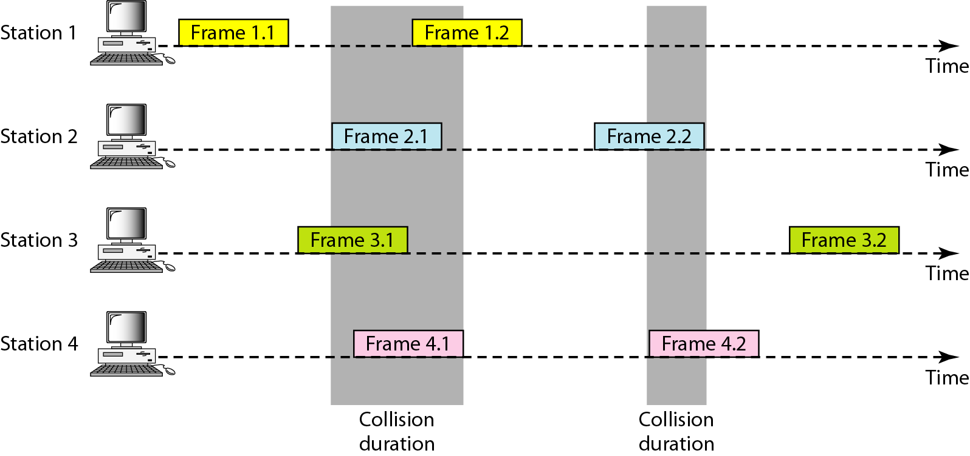
Procedure for pure ALOHA protocol

Slide 72
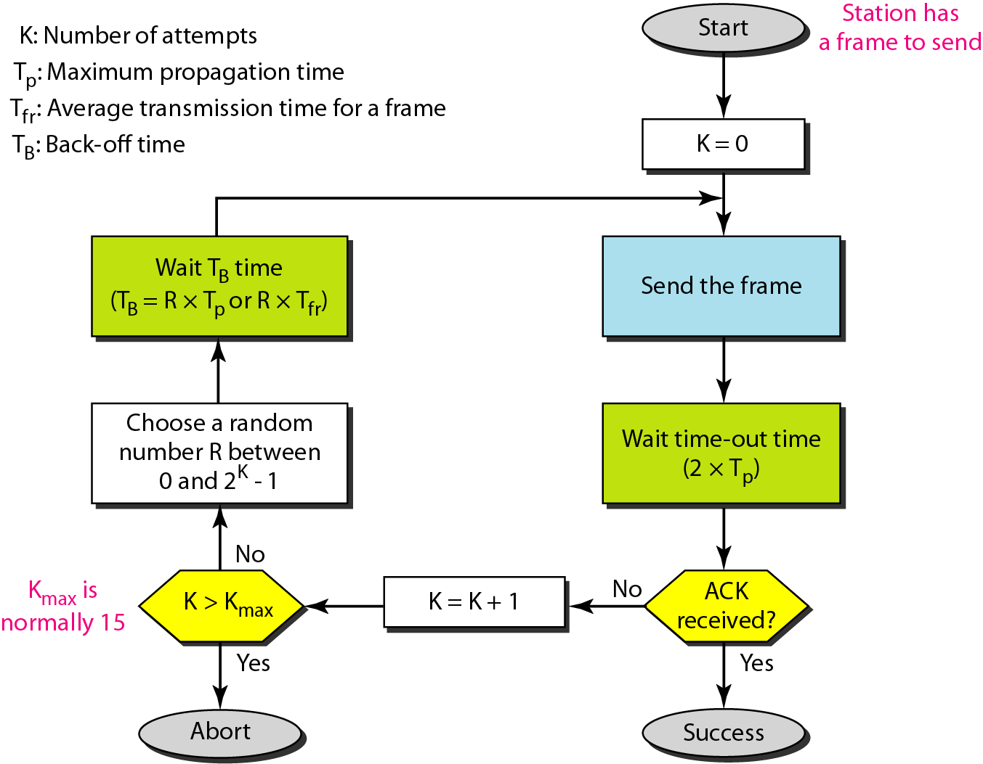
Procedure for pure ALOHA protocol

Slide 73
Carrier Sense Multiple Access (CSMA)
Protocols that listen for a carrier and act accordingly are called carrier sense protocols.
Carrier sensing allows the station to detect whether the medium is currently being used.
Schemes that use a carrier sense circuits are classed together as carrier sense multiple access or CSMA schemes.
There are two variants of CSMA. CSMA/CD and CSMA/CA
The simplest CSMA scheme is for a station to sense the medium, sending packets immediately if the medium is idle.
If the station waits for the medium to become idle it is called persistent otherwise it is called non persistent.

Slide 74
Persistent
Persistent:-wait if busy and transmit only when the media becomes idle again (not transmission after a triggered timer expire)
When a station has the data to send, it first listens the channel to check if anyone else is transmitting data or not.
If it senses the channel idle, station starts transmitting the data.
If it senses the channel busy it waits until the channel is idle, by continuously sensing the channel.

Slide 75
Non-Persistent
Non persistent CSMA is less aggressive compared to persistent protocol.
In this protocol, before sending the data, the station senses the channel and if the channel is idle it starts transmitting the data.
But if the channel is busy, the station does not continuously sense it but instead of that it waits for random amount of time and repeats the algorithm.
Here the algorithm leads to better channel utilization but also results in longer delay compared to persistent.

Slide 76
Carrier Sense Multiple Access/Collision Detection (CSMA/CD)
CSMA/CD is a technique for multiple access protocols.
If no transmission is taking place at the time, the particular station can transmit.
If two stations attempt to transmit simultaneously, this causes a collision, which is detected by all participating stations.
After a random time interval, the stations that collided attempt to transmit again.
If another collision occurs, the time intervals from which the random waiting time is selected are increased step by step.
This is known as exponential back off.
Notes:
Reading Assignment: Read About CSMA/CA and understand the difference with CSMA/CD

Slide 77
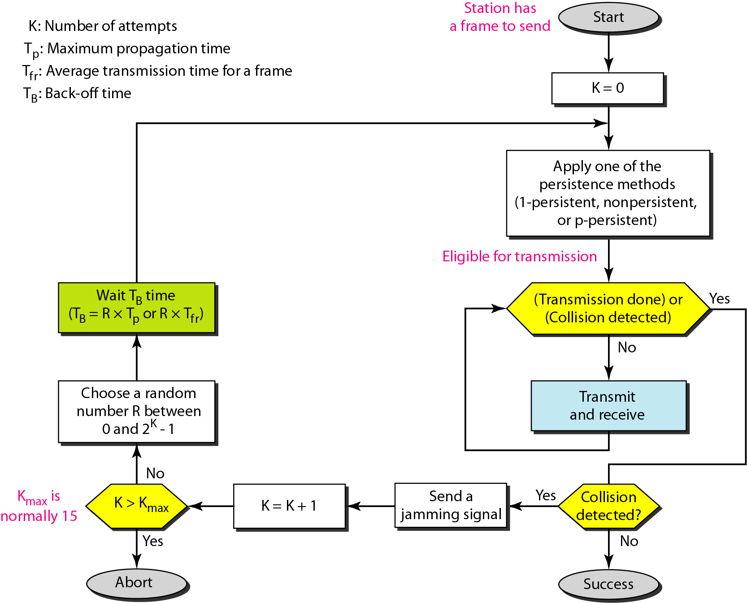
Flow diagram for the CSMA/CD
Reading Assignment: Read About CSMA/CA and understand the difference with CSMA/CD

Slide 78
3.2 Controlled access
In controlled access, the stations consult one another to find which station has the right to send.
A station cannot send unless it has been authorized by other stations.

Slide 79
Reservation
In the reservation method, a station needs to make a reservation before sending data.
Time is divided into intervals.
In each interval, a reservation frame precedes the data frames sent in that interval.
If there are N stations in the system, there are exactly N reservation minis lots in the reservation frame.
Each mini slot belongs to a station.
When a station needs to send a data frame, it makes a reservation in its own minis lot.

Slide 80
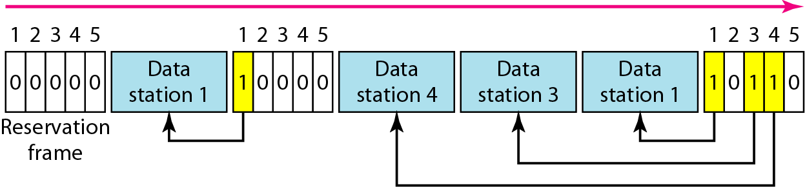
Contd.
The stations that have made reservations can send their data frames after the reservation frame.
The following figure shows a situation with five stations and a five-minis lot reservation frame.
In the first interval, only stations 1, 3, and 4 have made reservations.
In the second interval, only station 1 has made a reservation.

Slide 81
Polling
Polling works with topologies in which one device is designated as a primary station and the other devices are secondary stations.
All data exchanges must be made through the primary device even when the ultimate destination is a secondary device.
The primary device controls the link; the secondary devices follow its instructions.
It is up to the primary device to determine which device is allowed to use the channel at a given time.
The primary device, therefore, is always the initiator of a session.

Slide 82
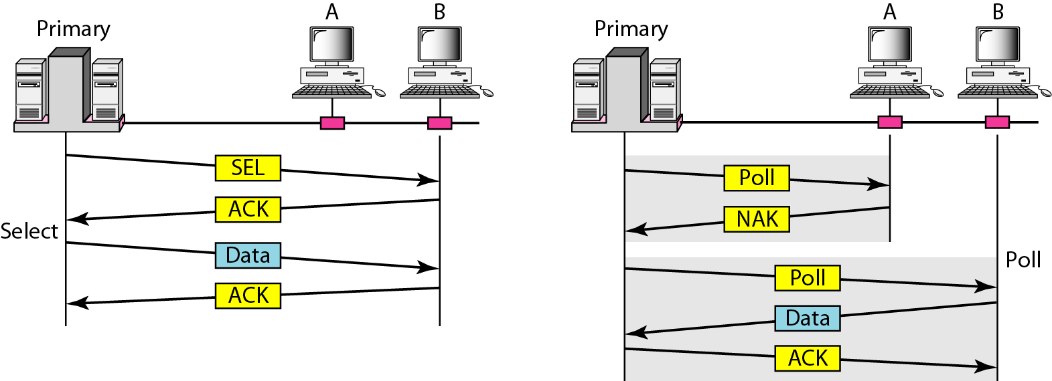
Contd.
If the primary wants to receive data, it asks the secondary devices if they have anything to send; this is called poll function.
If the primary wants to send data, it tells the secondary to get ready to receive; this is called select function.

Slide 83
Token Passing
In the token-passing method, the stations in a network are organized in a logical ring.
In other words, for each station, there is a predecessor and a successor.
The predecessor is the station which is logically before the station in the ring;
the successor is the station which is after the station in the ring.
The current station is the one that is accessing the channel now.

Slide 84
Contd.
The right to this access has been passed from the predecessor to the current station.
The right will be passed to the successor when the current station has no more data to send.
But how is the right to access the channel passed from one station to another?
In this method, a special packet called a token circulates through the ring.
The possession of the token gives the station the right to access the channel and send its data.

Slide 85
Contd.
When a station has some data to send, it waits until it receives the token from its predecessor.
It then holds the token and sends its data.
When the station has no more data to send, it releases the token, passing it to the next logical station in the ring.
The station cannot send data until it receives the token again in the next round.

Slide 86
3. Network Layer (3rd OSI Layer)
Concerned with getting packets from source to destination.
The network layer must know the topology of the subnet and choose appropriate paths through it.
When source and destination are in different networks, the network layer must deal with these differences.
The network layer is responsible for the
source-to-destination delivery of a packet,
possibly across multiple networks.

Slide 87
3. Network Layer (3rd OSI Layer)-------
Whereas the data link layer oversees the delivery of the packet between two
systems on the same network, the network layer ensures that each packet gets from its
point of origin to its final destination.
If two systems are connected to the same local network, there is usually no need for a network layer.
However, if the two systems are attached to different networks with connecting devices between the networks,
there is often a need for the network layer to accomplish source-to-destination delivery.

Slide 88
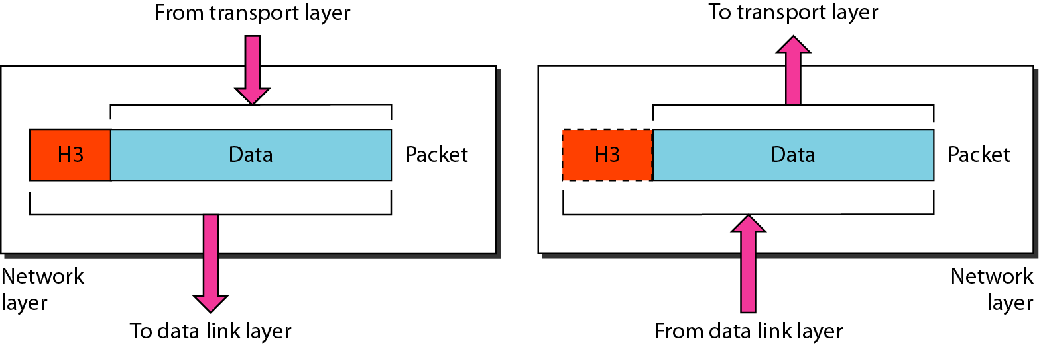
Contd.
The network layer is responsible for the delivery of individual packets from the source host to the destination host.

Slide 89
Contd.
Other responsibilities of the network layer include the following:
Logical addressing:-
The physical addressing implemented by the data link layer handles the addressing problem locally.
If a packet passes the network boundary, we need another addressing system to help distinguish the source and destination systems.
The network layer adds a header to the packet coming from the upper layer that, among other things, includes the logical addresses of the sender and receiver.

Slide 90
Contd.
2. Routing:-
When independent networks or links are connected to create internetworks (network of networks) or a
large network, the connecting devices (called routers or switches) route or switch the packets to their final destination.
One of the functions of the network layer is to provide this mechanism.

Slide 91
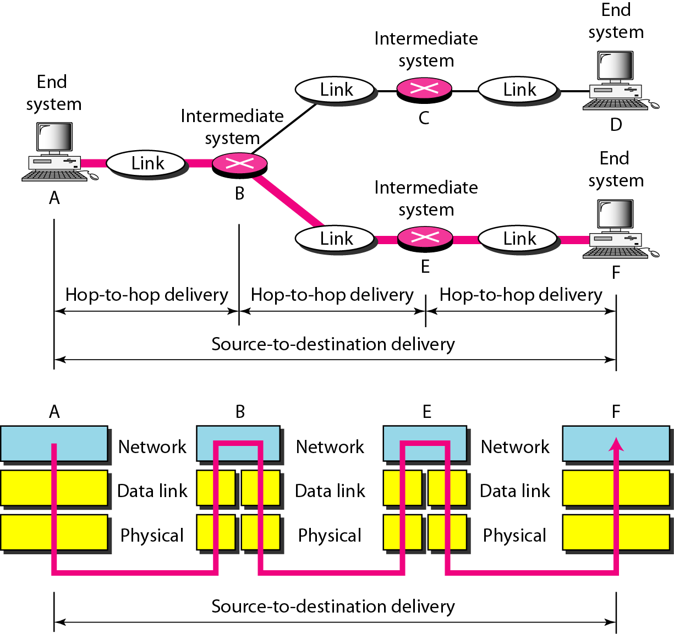
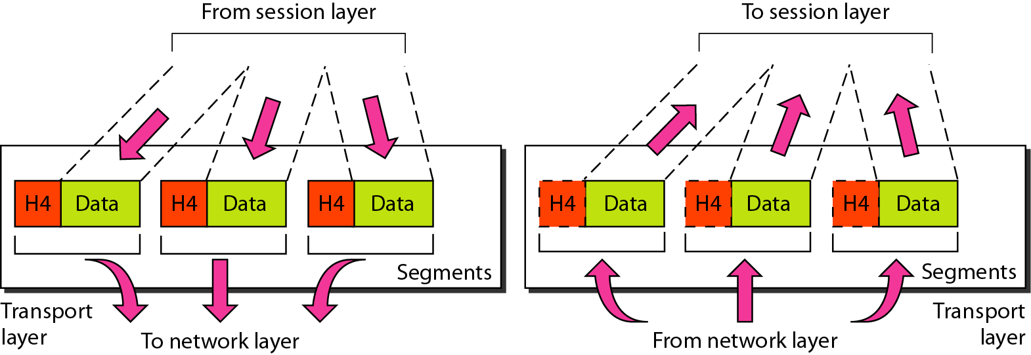
Contd.

Slide 92
4. Transport layer (4th OSI layer)
The transport layer is responsible for process-to-process delivery of the entire message.
A process is an application program running on a host.
Whereas the network layer oversees source-to-destination delivery of individual packets, it does not recognize any relationship between those packets.
The network layer treats each packet independently, as though each piece belonged to a separate message, whether or not it does.
The transport layer, on the other hand, ensures that the whole message arrives intact and in order, overseeing both error control and flow control at the source-to-destination level.

Slide 93
Major functions of the transport layer
The Transport layer encompasses these functions:
Enables multiple applications to communicate over the network at the same time on a single device
Ensures that, if required, all the data is received reliably and in order by the correct application
Employs error handling mechanisms

Slide 94
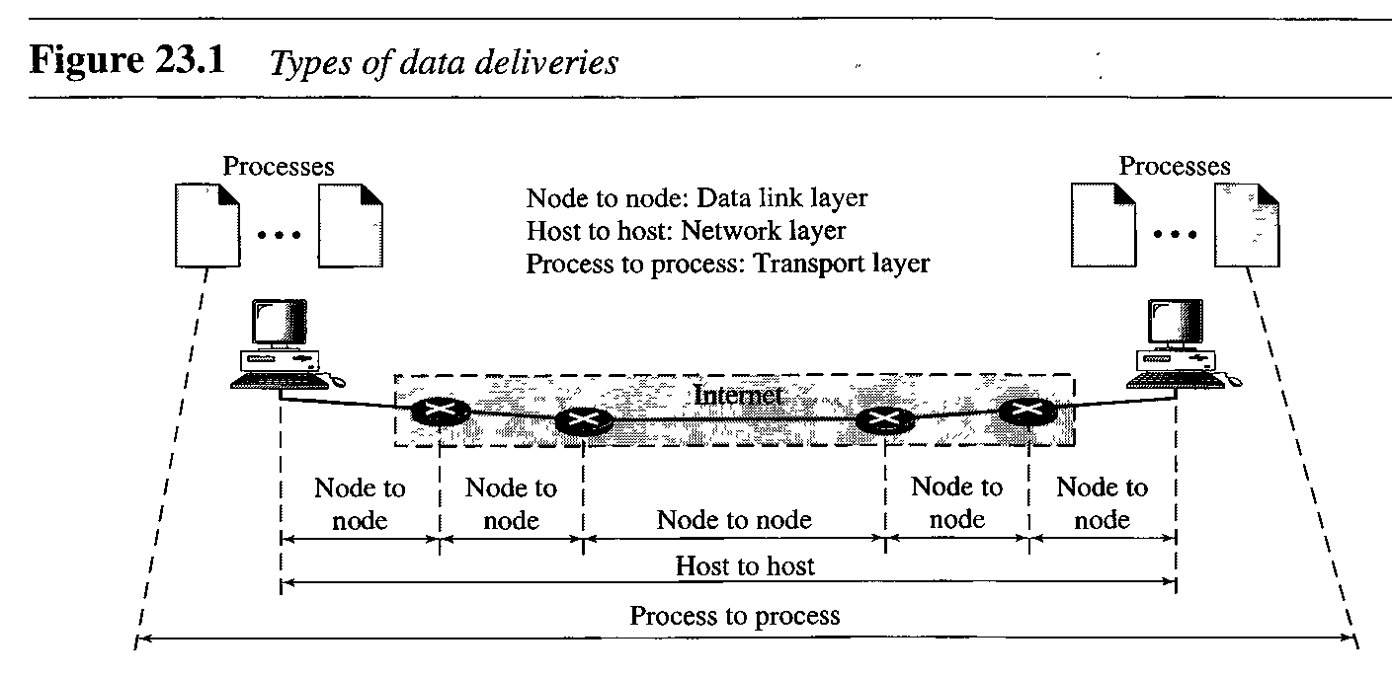
Contd.

Slide 95
Responsibilities Transport Layer
Service-point addressing
Computers often run several programs at the same time.
For this reason, source-to-destination delivery means delivery not only from one computer to the next but also from a specific process
(running program) on one computer to a specific process on the other.
The transport layer header must therefore include a type of address called a service-point address (or port address).

Slide 96
Responsibilities Transport Layer-------
The network layer gets each packet to the correct computer;
the transport layer gets the entire message to the correct process on that computer.
2. Segmentation and reassembly
A message is divided into transmittable segments, with each segment containing a sequence number.
These numbers enable the transport layer to
reassemble the message correctly upon arriving at the destination and to identify and replace packets
that were lost in transmission.

Slide 97
Contd.
Flow control
Like the data link layer, the transport layer is responsible for flow control.
However, flow control at this layer is performed end to end rather than across a single link.
Error control
Like the data link layer, the transport layer is responsible for error control.
However, error control at this layer is performed process-to-process rather than across a single link.

Slide 98
Contd.
The sending transport layer makes sure that the entire message arrives at the receiving transport layer without error (damage, loss, or duplication).
Error correction is usually achieved through retransmission.
Connection control
The transport layer can be either connectionless or connection-oriented.

Slide 99
Contd.
Connectionless
Transport layer treats each segment as an independent packet and delivers it to the transport layer at the destination machine.
Connection-oriented
Transport layer makes a connection with the transport layer at the destination machine first before delivering the packets.
After all the data are transferred, the connection is terminated.

Slide 100
1. Process-to-Process Delivery
As a revision, the data link layer is responsible for delivery of frames between two neighboring nodes over a link.
This is called node-to-node delivery.
The network layer is responsible for delivery of packets between two hosts.
This is called host-to-host delivery.
Communication on the Internet is not defined as the exchange of data between two nodes or between two hosts.
Real communication takes place between two processes (application programs).

Slide 101
1. Process-to-Process Delivery---
We need process-to-process delivery.
However, at any moment, several processes may be running on the source host and several on the destination host.
To complete the delivery, we need a mechanism to
deliver data from one of these processes running on the source host to the corresponding
process running on the destination host.
The transport layer is responsible for process-to-process delivery-the delivery of a packet, part of a message, from one process to another.
Two processes communicate in a client/server relationship.

Slide 102
2. Transport layer addressing
Whenever we need to deliver something to one specific destination among many, we need an address.
At the data link layer, we need a MAC address to choose one node among several nodes if the connection is not point-to-point.
A frame in the data link layer needs a destination MAC address for delivery and a source address for the next node's reply.
At the network layer, we need an IP address to choose one host among millions.

Slide 103
Contd.
A datagram in the network layer needs a destination IP address for delivery and a source IP address for the destination's reply.
At the transport layer, we need a transport layer address, called a port number, to choose among multiple processes running on the destination host.
The destination port number is needed for delivery; the source port number is needed for the reply.
In the Internet model, the port numbers are 16-bit integers between 0 and 65,535.

Slide 104
Contd.
The client program defines itself with a port number, chosen randomly by the transport layer software running on the client host.
This is the ephemeral (temporal) port number.

Slide 105
3. Identifying Applications (Processes)
In order to pass data streams to the proper applications, the Transport layer must identify the target application.
To accomplish this, the Transport layer assigns an application identifier called a port number.
Each software process that needs to access the network is assigned a port number unique in that host
This port number is used in the transport layer header to indicate to which application that piece of data is associated.
The server process must also define itself with a port number.
This port number, however, cannot be chosen randomly.

Slide 106
Contd.
If the computer at the server site runs a server process and assigns a random number as the port number,
the process at the client site that wants to access that server and use its services will not know the port number.
Of course, one solution would be to send a special packet and request the port number of a specific server, but this requires more overhead.
The Internet has decided to use universal port numbers for servers; these are called well-known port numbers.
Example of well known port numbers: 21 for FTP, 23 telnet, 25 SMTP, 80 HTTP, etc

Slide 107
Internet Assigned Number Authority (IANA) Ranges
There are some exceptions to this rule; for example, there are clients that are assigned well-known port numbers.
Every client process knows the well-known port number of the corresponding server process.
1. Well-known ports.
The ports ranging from 0 to 1023 are assigned and controlled by lANA. These are the well-known ports.
2. Registered ports.
The ports ranging from 1024 to 49,151 are not assigned or controlled by lANA.

Slide 108
Internet Assigned Number Authority (IANA) Ranges
They can only be registered with lANA to prevent duplication.
3. Dynamic ports.
The ports ranging from 49,152 to 65,535 are neither controlled nor registered.
They can be used by any process.
These are the ephemeral ports (temporary ports).

Slide 109
Socket Addresses
Process-to-process delivery needs two identifiers, IP address and the port number, at each end to make a connection.
The combination of an IP address and a port number is called a socket address.
The client socket address defines the client process uniquely just as the server socket address defines the server process uniquely.
A transport layer protocol needs a pair of socket addresses: the client socket address and the server socket address.

Slide 110

Socket Addresses
These four pieces of information are part of the IP header and the transport layer protocol header.
The IP header contains the IP addresses; the UDP or TCP header contains the port numbers.

Slide 111
Transport Layer Protocols
A transport layer protocol can either be connectionless or connection-oriented.
Connectionless Service
In a connectionless service, the packets are sent from one party to another with no need for connection establishment or connection release.
The packets are not numbered; they may be delayed or lost or may arrive out of sequence.
There is no acknowledgment either.
UDP is connectionless.

Slide 112
Connectionless Versus Connection-Oriented Service---
2. Connection-Oriented Service
In a connection-oriented service, a connection is first established between the sender and the receiver.
Data are transferred. At the end, the connection is released.
TCP and SCTP are connection-oriented protocols.

Slide 113
Reliable Versus Unreliable
The transport layer service can be reliable or unreliable.
If the application layer program needs reliability,
we use a reliable transport layer protocol by implementing flow and error control at the transport layer.
This means a slower and more complex service.
On the other hand, if the application program does not need reliability because
it uses its own flow and error control mechanism or
it needs fast service or the nature of the service does not demand flow and error control (real-time applications),
then an unreliable protocol can be used.

Slide 114
Reliable Versus Unreliable
In the Internet, there are two common different transport layer protocols, as we have already mentioned.
UDP is connectionless and unreliable;
TCP and SCTP are connection-oriented
and reliable protocols.
These three can respond to the demands of the application layer programs.

Slide 115
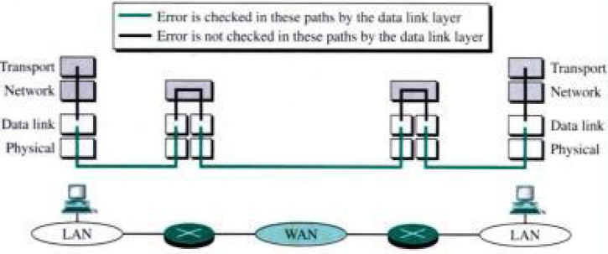
Why flow control and error control at the transport layer as we have it at the data link layer???

Slide 116
USER DATAGRAM PROTOCOL (UDP)
The User Datagram Protocol (UDP) is called a connectionless, unreliable transport protocol.
It does not add anything to the services of IP except to provide process-to-process communication.
Also, it performs very limited error checking. If UDP is so powerless, why would a process want to use it?
With the disadvantages come some advantages. UDP is a very simple protocol using a minimum of overhead.
If a process wants to send a small message and does not care much about reliability, it can use UDP.

Slide 117
Contd.
Sending a small message by using UDP takes much less interaction between the sender and receiver than using TCP or SCTP.
UDP packets, called user datagrams, have a fixed-size header of 8 bytes
1. Source port number.
This is the port number used by the process running on the source host.
2. Destination port number.
Used by the process running on the destination host.

Slide 118
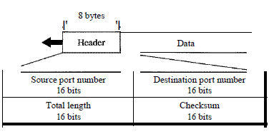
Cont------
3. Length
This is a 16-bit field that defines the total length of the user datagram, header plus data.

Slide 119
Contd.
UDP does not perform:
Flow control, Error control and connection control
All these functions are done by the processes (application layer programs) using UDP
UDP is not capable of segmenting and reassembling frames and does not implement sequence numbers
But UDP, like TCP, performs:
Service point addressing
UDP can transmit only small portions of data at a time because it is not capable of segmenting and reassembling frames and does not implement sequence numbers

Slide 120
Use of UDP
UDP is suitable for a process that requires simple request-response communication with little concern for flow and error control.
It is not usually used for a process such as FTP that needs to send bulk data
2. UDP is suitable for a process with internal flow and error control mechanisms.
For example, the Trivial File Transfer Protocol (TFTP) process includes flow and error control.
It can easily use UDP.

Slide 121
Use of UDP-----
3. UDP is a suitable transport protocol for multicasting.
Multicasting capability is embedded in the UDP software but not in the TCP software.
4. UDP is used for management processes such as SNMP.
5. UDP is used for some route updating protocols such as Routing Information Protocol (RIP).

Slide 122
Transmission Control Protocol (TCP)
TCP, like UDP, is a process-to-process (program-to-program) protocol.
TCP, therefore, like UDP, uses port numbers.
Unlike UDP, TCP is a connection-oriented protocol; it creates a virtual connection between two TCPs to send data.
In addition, TCP uses flow and error control mechanisms at the transport level.
In brief, TCP is called a connection-oriented, reliable transport protocol.
It adds connection-oriented and reliability features to the services of IP.

Slide 123
TCP Services
Process-to-Process Communication:-
Like UDP, TCP provides process-to-process communication using port numbers.
2. Stream Delivery Service
3. Full-Duplex Communication
4. Connection-Oriented Service
5. Reliable Service

Slide 124
5. Session Layer
The lowest four layers of the OSI model (Physical, Data link, Network, and Transport) provide the means for the reliable exchange of data and provide a fast data service.
For example, a remote terminal access application might require a half-duplex dialogue.
A transaction-processing application might require checkpoints in the data-transfer stream to permit backup and recovery.
A message processing application might require the ability to interrupt a dialogue in order to prepare a new portion of a message and later to resume the dialogue where it was left off.

Slide 125
Cont----
All these capabilities could be embedded in specific applications at layer 7.
However, because these types of dialogue-structuring tools have widespread applicability, it makes sense to organize them into a separate layer: the session layer.
The session layer provides the mechanism for controlling the dialogue between applications in end systems.
In many cases, there will be little or no need for session-layer services,
but for some applications, such services are used.

Slide 126
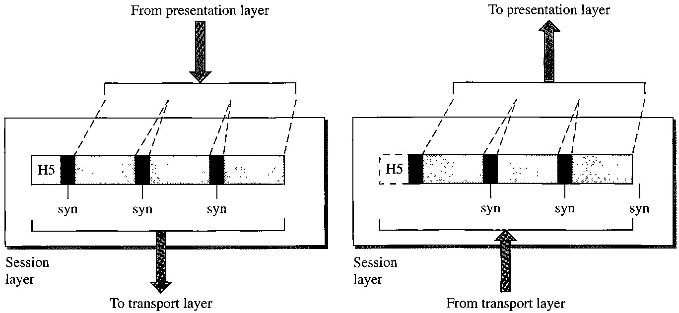

Slide 127
Key Services provided by the Session Layer
1. Dialogue discipline.
This can be two-way simultaneous (full duplex) or two way alternate (half duplex) communication between processes.
2. Grouping.
The flow of data can be marked to define groups of data.
For example, if a retail store is transmitting sales data to a regional office, the data can be marked to indicate the end of the sales data for each department;
this would signal the host computer to finalize running totals for that department and start new running counts for the next department.

Slide 128
Key Services provided by the Session Layer
3. Recovery.
The session layer can provide a check pointing mechanism,
so that if a failure of some sort occurs between checkpoints, the session entity can retransmit all data since the last checkpoint.
For example, if a system is sending a file of 2000 pages,
it is advisable to insert checkpoints after every 100 pages to ensure that each 100-page unit is received and acknowledged independently.

Slide 129
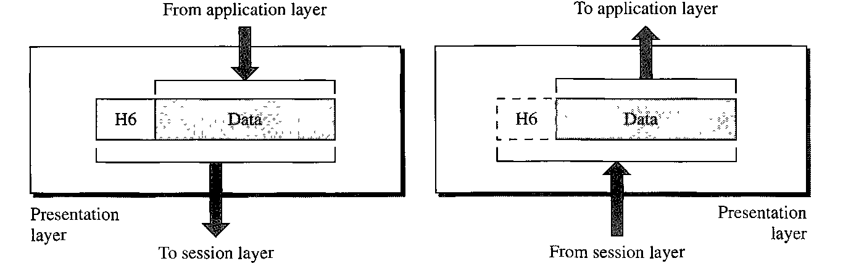
6. Presentation Layer
The presentation layer is concerned with the syntax and semantics of the information exchanged between two systems.

Slide 130
Specific responsibilities of the presentation layer :
Translation
The processes (running programs) in two systems are usually exchanging information in the form of character strings, numbers, and so on.
The information must be changed to bit streams before being transmitted.
Because different computers use different encoding systems, the presentation layer is responsible for interoperability between these different encoding methods.

Slide 131
Specific responsibilities of the presentation layer :
The presentation layer at the sender changes the information from its sender-dependent format into a common format.
The presentation layer at the receiving machine changes the common format into its receiver-dependent format.
2. Encryption
To carry sensitive information, a system must be able to ensure privacy.
Encryption means that the sender transforms the original information to another form and sends the resulting message out over the network.

Slide 132
Specific responsibilities of the presentation layer :
Decryption reverses the original process to transform the message back to its original form.
3. Compression
Data compression reduces the number of bits contained in the information.
Data compression becomes particularly important in the transmission of multimedia such as text, audio, and video.

Slide 133
7. Application Layer
The application layer enables the user, whether human or software, to access the network.
It provides user interfaces and support for services such as electronic mail, remote file access and transfer, shared database management, and other types of distributed information services.
Application layer is where users actually communicate to the computer.
Take the case of Internet Explorer (IE).
It is also responsible for identifying and establishing the availability of the intended communication partner

Slide 134
Typical application layer protocols
Hyper Text Transfer Protocol (HTTP)
File Transfer Protocol (FTP)
E-mail (SMTP,POP,IMAP)
Domain Name System (DNS)
1. Domain Name System (DNS)
Thousands of servers, installed in many different locations, provide the services we use over the Internet.
Each of these servers is assigned a unique IP address
It would be impossible to remember all of the IP addresses

Slide 135
DNS continued...
DNS provides a way for hosts to use this name to request the IP address of a specific server.
DNS names are registered and organized on the Internet within specific high level groups, or domains.
Some of the most common high level domains on the Internet are .com, .edu, and .net
A DNS server contains a table that associates hostnames in a domain with corresponding IP addresses

Slide 136
Web client and web server
A web client first receives the IP address of a web server from DNS server
Then the client browser uses that IP address and port 80 to request web services
This request is sent to the server using the Hypertext Transfer Protocol (HTTP)
The information content of a web page is encoded using specialized 'mark-up' languages.
E.g. HTML (Hypertext Mark-up Language)
Many different web servers and web clients from many different manufactures work together seamlessly because of HTTP and HTML

Slide 137
2. File Transfer Protocol (FTP)
FTP is another common service used across the Internet that allows users to transfer files
A host running FTP client software can access an FTP server to perform various file management functions including file uploads and downloads
FTP service uses two different ports to communicate between client and server
Requests to begin an FTP session are sent to the server using destination port 21.
Once the session is opened, the server will change to port 20 to transfer the data files
FTP client software is built into computer operating systems and into most web browsers

Slide 138
3. E-mail
Each mail server receives and stores mail for users who have mailboxes configured on the mail server
Each user with a mailbox must then use an email client to access the mail server and read these messages
Mailboxes are identified by the format: user@company.domain
Three application protocols used in processing email include:

Slide 139
Simple Mail Transfer Protocol (SMTP):
To send mail from client to server or server to server
Post Office Protocol (POP3):
To download email from server to client, and the server deletes the mail
Internet Message Access Protocol (IMAP4):
To download email from server to client, and the server does not delete (keeps) the mail

Slide 140
Activity
1. Which one of the following is not correct about POP3 and SMTP?
A. A sender can send email using SMTP
B. Both are application layer protocols
C. Both are Network Layer protocols
D. A sender can receive email using POP3
2. Which type of network is the largest as compared to the rest?
A. Metropolitan Area Network
B. The Internet
C. Local Area Network
D. Wide Area Network

Slide 141
Activity------
3. A university owns a number of private local area and wide area networks, which are designed for an access by its academic staff, students and administrative workers. Which term best describes the University’s network?
A. Wide Area Network
B. Metropolitan Area Network
C. The Internet
D. Local Area Network
4. Which layer uses port number to identify applications?
A. Application layer C. Network Layer
B. Physical layer D. Transport Layer

Slide 142
Activity-------
5. At which layer of the OSI model devices such as bridges, switches and Network Interface Cards (NICs) are used?
A. Application layer
B. Physical layer
C. Network layer
D. Data link layer
6. Write the difference and similarities between UDP and TCP transport Layer Protocols?

Slide 143
2. TCP/IP Reference Model
TCP/IP Reference Model is a four-layered suite of communication protocols.
It is named after the two main protocols that are used in the model,
namely, TCP TCP/IP stands for Transmission Control Protocol / Internet Protocol
It was developed by the DoD (Department of Defence) in the 1960s as a model able to withstand intense military attack and not fail.
Data transmission was possible to any destination on the network under any circumstances.
Standardized in 1981, the TCP/IP model is now the standard on which the Internet is based.

Slide 144
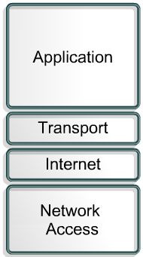
2. TCP/IP Reference Model------
It has four layers
There are similarities and differences between the TCP/IP model and the seven layer OSI model.

Slide 145

1. TCP/IP Application Layer
Ensures that the data is properly packaged before being passed on.
Handles high-level protocols, representation, encoding, and dialog control.
There are lots of protocols defined at this layer:
Simple Network Management Protocol (SNMP) – allows network managers to manage configurations, statistics, performance, and security.
Domain Name System (DNS) – used to translate domain names into IP addresses.
145

Slide 146
1. TCP/IP Application Layer------
Has protocols to support file transfer, e-mail, and remote login.
File Transfer:
Trivial File Transfer Protocol (TFTP)
Unreliable, connectionless User Datagram Protocol (UDP) service used to transfer configuration files, Cisco IOS images, and to transfer files in a LAN.
2. File Transfer Protocol (FTP)
Reliable, connection-oriented service that uses TCP to transfer files between systems
3. Network File System (NFS)
Allows file access to a remote storage device such as a hard disk
146

Slide 147
1. TCP/IP Application Layer------
E-mail:
Simple Mail Transfer Protocol (SMTP)
Administers the transmission of plain text e-mail between email servers.
2. Post Office Protocol (POP3) and IMAP4
Handles email transfer between a mail server and client machine
2. Remote Access:
Telnet
A protocol that remotely access a computer, enabling a user to log into an Internet host and execute commands.
A Telnet client is called a local host. A Telnet server is called a remote host.
147

Slide 148
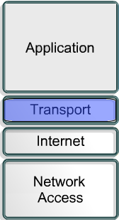
2. TCP/IP Transport Layer
Provides a logical connection between a source host and a destination host.
Transport Layer protocols segment and reassemble data sent by applications, into the same data stream, between end points.
Provides end-to-end control and reliability as data travels through the cloud, accomplished through:
sequence numbers, acknowledgments and sliding windows.
148

Slide 149
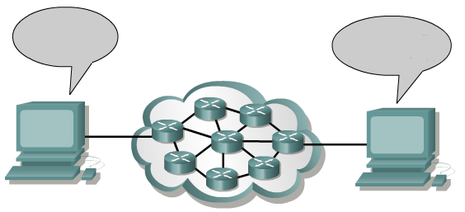


2. TCP/IP Transport Layer-------
Transport
I just sent #10
I just received #10
Now I need #11
This shows sequence numbers and acknowledgements.
149

Slide 150
2. TCP/IP Transport Layer-------
Sliding Windows
Transport
I just sent #11, 12 and 13
I just received #12
Now I need #13
This indicates that packet 13 either did not arrive, or arrived with errors, and needs retransmission.
150

Slide 151
2. TCP/IP Transport Layer-------
Transport
Sliding Windows
I just sent #13 and 14
I just received #14
Now I need #15
The sliding window has worked as the last packet sent has arrived.
151

Slide 152
2. TCP/IP Transport Layer-------
The only Transport layer protocols are TCP and UDP.
1. Transmission Control Protocol (TCP)
Connection-oriented protocol
End-to-end operation
Flow control – sliding windows
Reliability–sequence numbers and acknowledgments
2. User Datagram Protocol (UDP)
Connectionless
Unreliable (no acknowledgments or error checking)
Transport
152

Slide 153
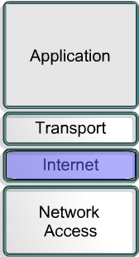
3. TCP/IP Internet Layer
Two purposes are - determining the best path and packet-switching.
No error checking or correction
Protocols:
Internet Protocol (IP) - connectionless, best-effort delivery routing of packets; determines best path to destination
Internet Control Message Protocol (ICMP) – control and messaging
Address Resolution Protocol (ARP) - determines the MAC address, for a known IP address.
Reverse Address Resolution Protocol (RARP) - determines the IP address for a known MAC address.
Internet
153

Slide 154
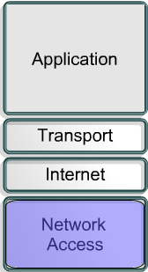
4. TCP/IP Network Access Layer
Allows an IP packet to make a physical link to the network media
Maps IP addresses to MAC addresses
Encapsulates IP packets into frames
Drivers for modem cards, and other devices operate at the network access layer.
Serial Line Internet Protocol (SLIP) and Point-to-Point Protocol (PPP) provide network access.
ARP and RARP also work at this layer.
Network Access
154
Note: This layer is not defined by TCP/IP.

Slide 155
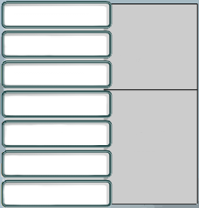

Comparing TCP/IP and OSI
TCP/IP Model
OSI Model
7
Application
6
Presentation
Application Layers
Application
5
Session
4
Transport
Transport
3
Network
Data Flow Layers
Internet
2
Data Link
Network Access
1
Physical
155

Slide 156
Activity
Write the advantages and disadvantages of OSI Model
Write the advantages and disadvantages of TCP/IP Model
Write the difference and similarities between OSI and TCP/IP models
Are OSI and TCP concepts outdated?
Can TCP work without OSI?
Which layers of OSI are relevant to TCP?
Write the difference between Circuit-switching and Packet-switching?
Explain the term IP packet?

